Slide 1

Fully Connected Neural Networks
Audun Wigum Arbo, Christian Echtermeyer, Even Dalen
Notes:
Kan potensielt bare lag våres egen, noe ala det her

Slide 2
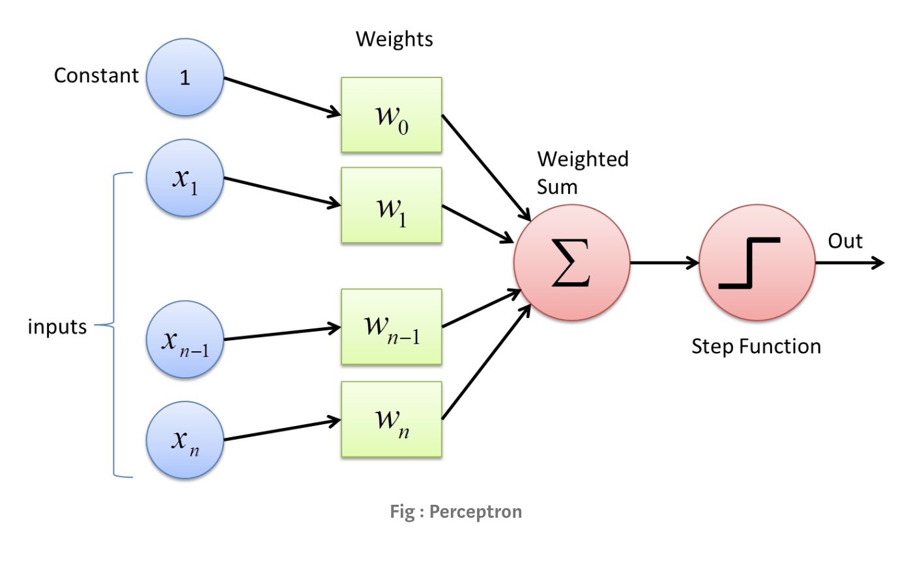
Perceptron
The building block of a artificial neural network
A simple binary classifier
The input is a set of values (x_0 to x_n)
Each edge has a weight that is multiplied with the input at that edge.
A weighted sum is calculated and sent to an activation function.
The result of the activation function is the output of a perceptron.
Notes:
Perceptron is the building block of a artificial neural network, and is modeled after the biological neuron.
The perceptron has a set of inputs, where each input has a corresponding weight.
The output of a perceptron is calculated through a weighted sum of the inputs and corresponding weight.
Then the result is sent to an activation function, for instance a step function, and the result is the output of the perceptron.

Slide 3
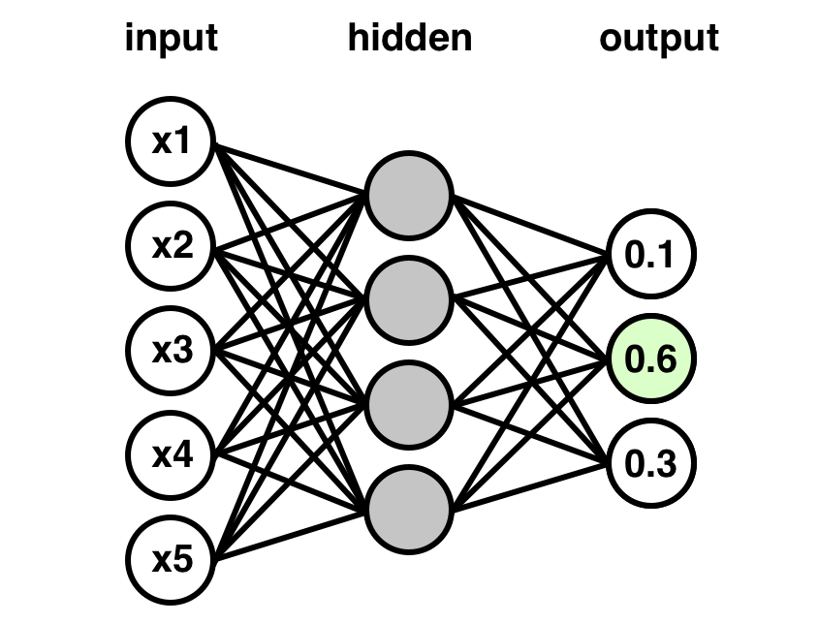
Artificial Neural Network
One input and one output layer. Layers between are called hidden layers.
Every unit on each layer is connected to every unit of the next layer (fully connected).
Works similar to the perceptron. Each edge has a weight, and output of each neuron is the result of an activation function.
The output of each neuron propagates forward through the network to the output layer.
Notes:
An artificial neural network has several layers of neurons. An input layer, one or more hidden layers and an output layer.
The network is a fully connected network when each unit on every layer is connected to each unit on the next layer.
The calculations work similar to the perceptron, where each edge has a weight, and the output is a result of an activation function. The result of each neuron is propagated forward through the network, to determine the final result in the output layer.

Slide 4
Input Layer
Hidden Layer
Output Layer
Notes:
An image of a fully connected neural network with two hidden layers.

Slide 5
Prediction - forward propagation
A neural network can represent an estimate h(x) of a concept c(x)
The values of the input layer acts as the input x of h
The values of the output layer acts as the output, h(x)
Notes:
The structure of a neural network can be utilized to do predictions.
The network itself can be seen as an estimate h(x) of a concept c(x), where the values of the input layer represents the input x of h
As we can calculate the output of each neuron, we can propagate values through the network, which will result in values in the output layer. These values are the output of h(x)

Slide 6
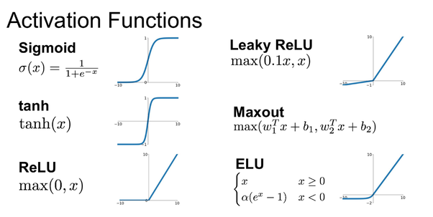
Notes:
A perceptron uses a step function to adjust the output values of each neuron unit
In neural networks this step function is usually replaced with another function, which often provides better results

Slide 7
Quick Notation Guide:
b^{i}
w^{i}
w^{i+1}
z^{i}
a^{i}
Notes:
To simplify the next parts, we use the following common notation:
b^i: The bias of this neuron
z^i: The product of the input and weights w^i to the neuron plus the bias b^i
a^i: The output of the activation function, which takes z^i as inpu

Slide 8
Input Layer
Hidden Layer
Output Layer
b¹
b²
w¹
w²
a⁰
z¹
a¹
z²
a²
Notes:
When added to each neuron in a network, the values looks like this:
We can now show an example where we do a prediction given some arbitrary weights, biases and input value a^0

Slide 9
ReLU Example
a = max (z, 0)
a = max (z, 0)
z = w * a + b
0.2
0
0.3
0.44
0.44
0.5
0.8
0.22
0.22
Notes:
Here we use ReLU as the activation function when calculating the output values. Observe that the a^i values will always equal their respective z^i values when z^i is positive

Slide 10
Training
The network learns by backpropagating the error of the network
The error is a function of the difference between the expected result and the actual result

Slide 11
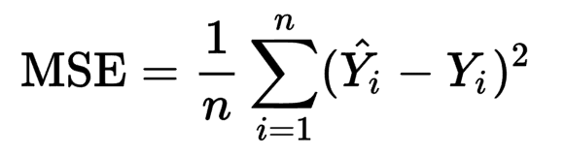
Training: Loss functions
Notes:
Veit ikke om det her e viktig å ha med, men la det te. Vi kan godt fjerne de neste 3 slidsa

Slide 12
Output Layer
Desired result: 0.5
(0.5 - 0.9)² = 0.16
0.9
= 0.16

Slide 13
Output Layer
Desired result: 1.0
0.1
(1.0 - 0.1)² = 0.81
Desired result: 0.5
(0.81+0.16+2.89)
0.9
(0.5 - 0.9)² = 0.16
3
Desired result: 2.0
(2.0 - 0.3)² = 2.89
= 1.286
0.3

Slide 14
Training
Once the network has a measure of "correctness" it can then update the weights and biases of the network to be more correct.
This is often done with a batch of random samples averaged out before a small step is taken in the "direction" that best optimizes the samples.

Slide 15
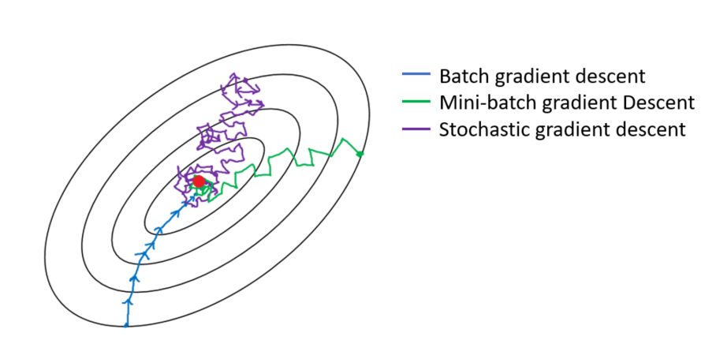

Slide 16
Summary
A Neural Network consists of neurons
A neuron simply holds a number value (activation)
In a fully connected network every neuron in one layer is connected to every neuron in the next.
Every connection has a weight
The activation of a neuron is decided by the weight and activation of the previous layer and the bias. This result is then passed through an activation function.
A FCNN can be divided into three layers: Input, Hidden and Output
The network learns by backpropagating the error

Slide 17
References
http://neuralnetworksanddeeplearning.com/
https://towardsdatascience.com/under-the-hood-of-neural-networks-part-1-fully-connected-5223b7f78528
https://towardsdatascience.com/coding-up-a-neural-network-classifier-from-scratch-977d235d8a24

